Slide 1
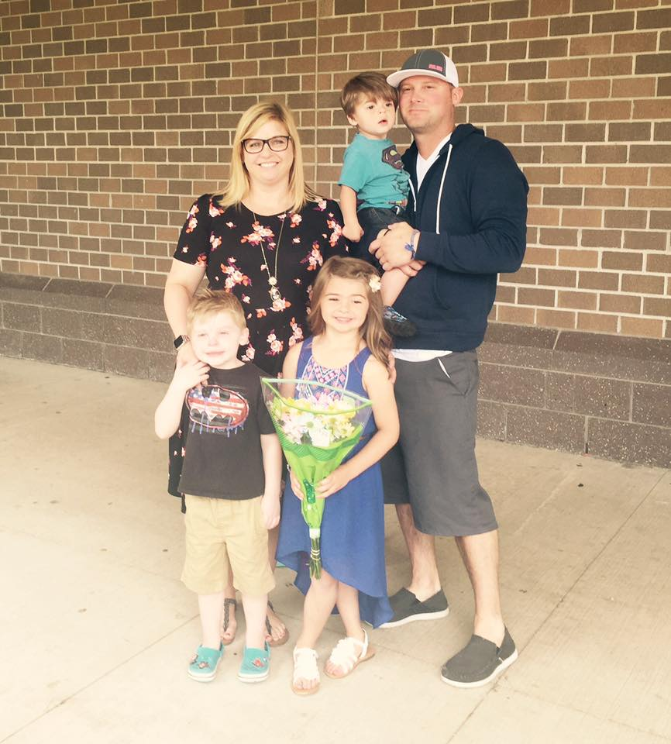
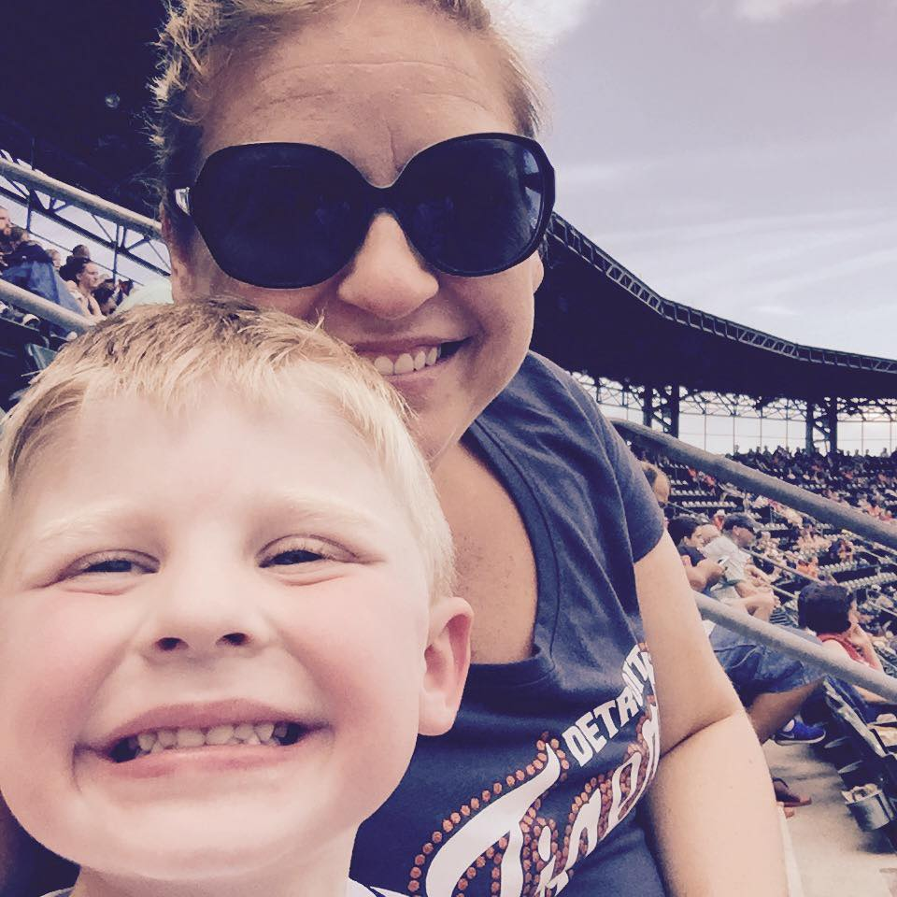
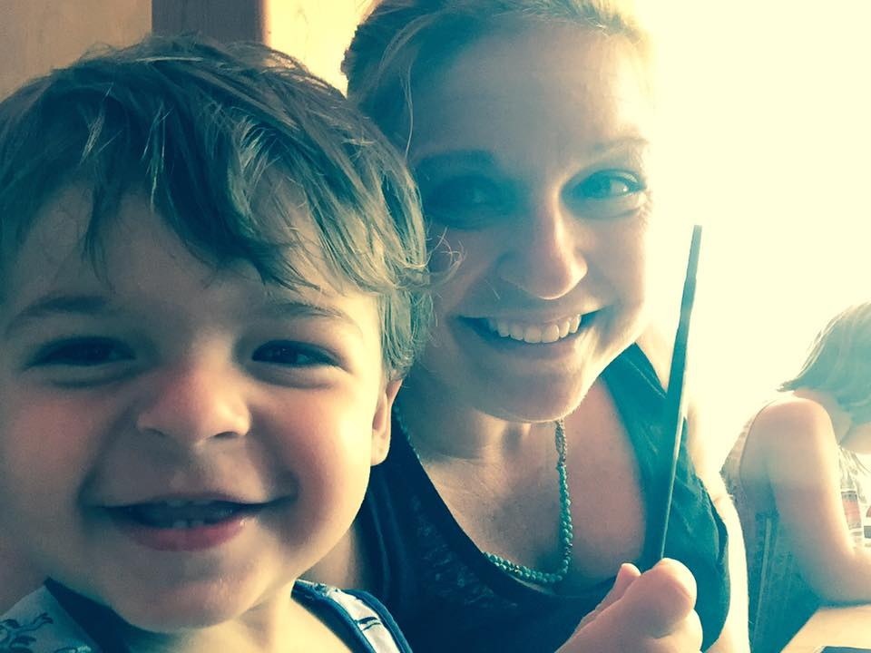
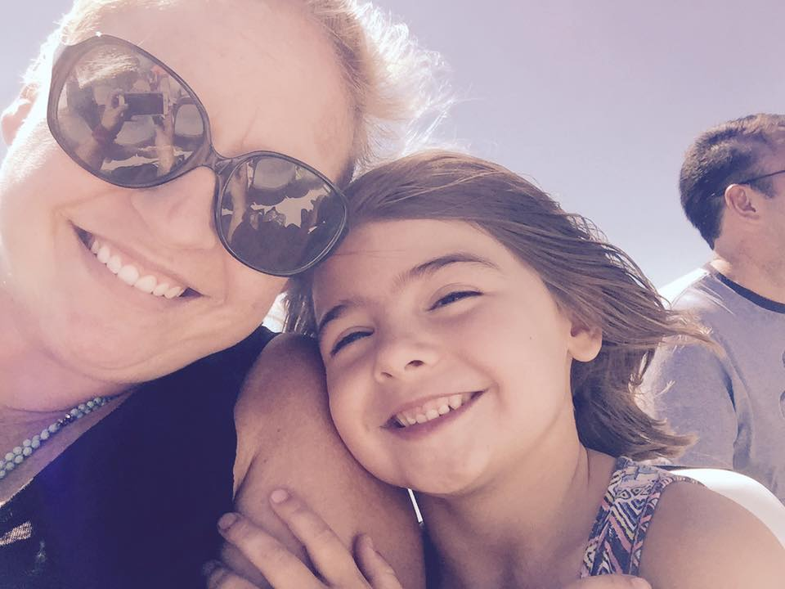
M
R
S.
G
O
U
G
H

Slide 2

Raise Hand for Attention
In order to get your attention I will raise my hand, when you see it, finish your sentence and direct your attention to me.
If someone around you continues to talk, simply raise your hand so they know I am ready to speak.

Slide 3
The “Blue Bell”
Another way I will get your attention is by ringing the blue bell. When you hear the blue bell ring that means I have something to say, finish your sentence and direct your attention to me.

Slide 4
Writer’s Notebooks/ Warm-Ups
At the beginning of class on a regular basis you will complete a warm-up.
It is your responsibility to keep your warm-ups organized: titled, dated and numbered. You begin each warm-up immediately after your previous one.

Slide 5
End of Class Procedures
Each week we will have a Pom Pusher.
Remind the last 3 minutes of class to Push for Poms
Exit Activity: My goal is to do an Exit Activity at the end of class everyday. This will review what we have learned in class that day and prepare us for the following day.

Slide 6


YELLOW ZONE
This is a yellow zone for music. You may bring it everyday but you many only listen to it when the music it is a green day. You may not go back to your locker for it.

Slide 7
Store Your Phone!
In order to avoid the temptation to use your phone during class, please place your cell phones in your assigned number at the beginning of each class.
We will use them, SOMETIMES!
If we need them I will let you know. Otherwise they should be off and in the cell phone holder.

Slide 8
PUSH FOR POMS
At the end of each class we will push for POMS!
POMS are rewarded for positive behavior☺
The class with the most POMS at the end of the trimester will have an ice cream party!!
There are many ways to earn POMS, you just need to be on your best behavior☺

Slide 9
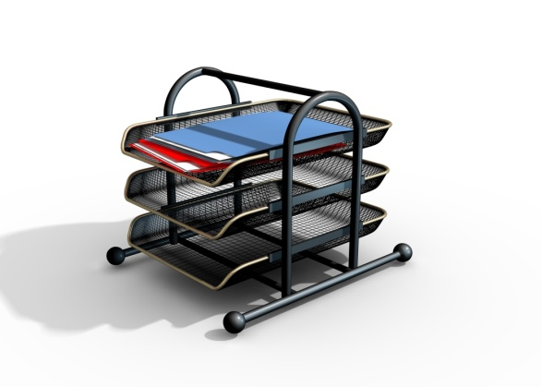


Where do I find it?
Who’s out?
Absent work
Extra Copies
Comfy Chairs
Pencils 25 cents
Mechanical pencils 50 cents
Recycle
Lost and Found

Slide 10
1st and 6th hour
Lights and Chairs and Fans

Slide 11
Pet Peeves?!
You tell me yours and I will tell you mine!!!!
Hands off my desk
Talking while I am talking
Talking while someone else is talking
Gum!
Unprepared
No names

